Slide 1

Milestone 1: Complete App UI with no functionality (tabs, layouts, CSS)
Team members:
Badr Elsayed - 22010664
Adham Anas- 22010601
Mohamed Mostafa Sayed - 22011170
Nour Khaled Mohamed - 22011319
Ali El-Deen Maher - 22010934
Yousef Awad – 22011390

Slide 2
List of accomplished tasks:
App UI with no functionality, only the minimum functionality for the GUI to work
Created 4 tabs: Tasks and Events, Calendar, Study Techniques, and Tasks Progress
Created a settings window: Change tasks/events preferences and change Theme which can be font or GUI, switching between light and dark.
Tasks and Events Tab: Add a task/event with an “Add” button, making a window appear that the user input all the info about the task/event. Currently only adding a task work, but you can’t input any info yet, just for showcase. A button for search and a button for sort.
Calendar Tab: All tasks and events will appear here. No functionality yet.
Study Techniques Tab: An area to help study/focus, has a drop box for the user to choose the study technique, and a Start button, Stop, and Reset button. No functionality yet.
Tasks Progress: Shows all completed and left tasks over the current week and over the previous month. No functionality yet.
More in depth in the upcoming screenshots of the app.

Slide 3
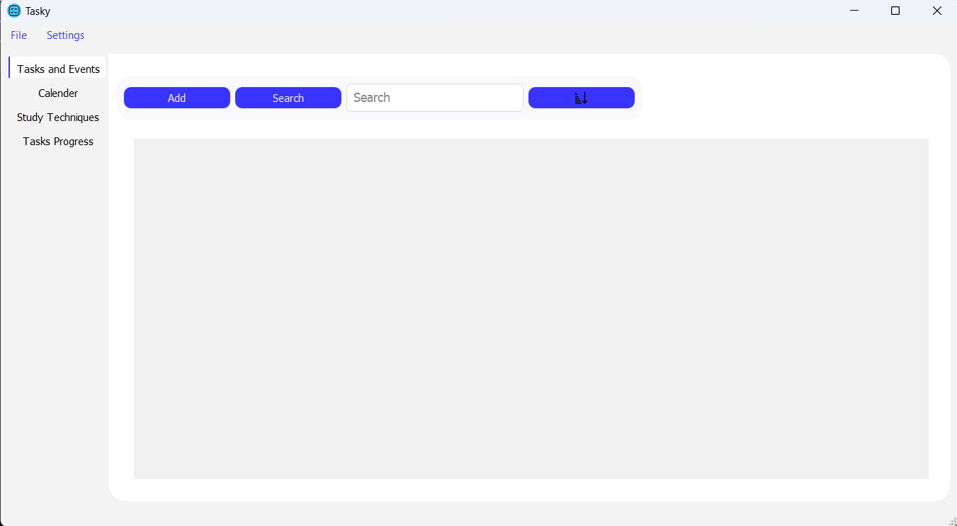
When we first open the app we see it has 4 tabs, and the first tab opened is called “Tasks and Events”, this is where we’ll see our tasks. We can start adding a task by clicking “Add”
Discussed Lastly

Slide 4
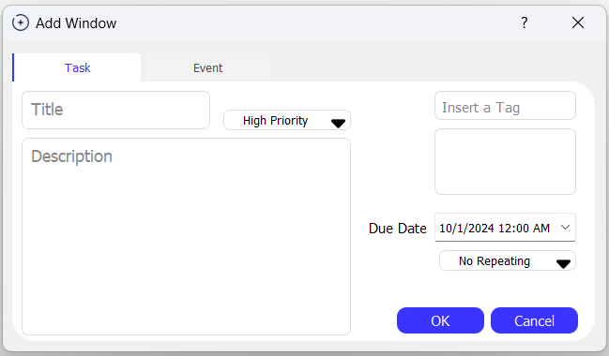
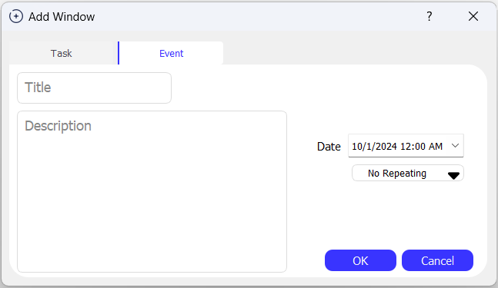
We’ll see a window open with 2 options, add a Task or add an Event. 1) Task: Most options are self explanatory. Tags are helpful when Searching. Priority is an indicator system for both visualization and sorting, as we’ll see in next slide. Tasks can be viewed in the Calender tab as well. 2) Event: A simpler version of a Task that appear only in the Calendar tab

Slide 5
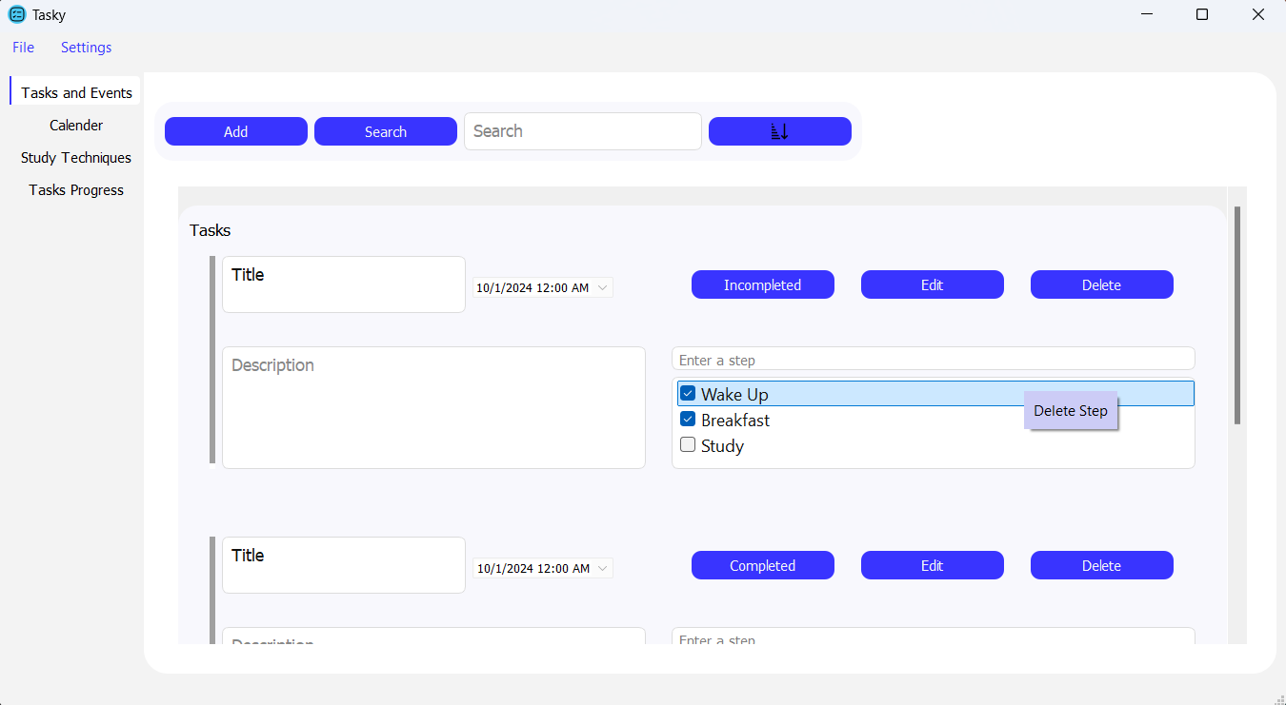
Added tasks will appear as shown, we can Search by Title or Tag. We have 2 sorting modes, sort by Due Dates (nearest to furthest) or sort by Priority (High to Low) and in each Priority, tasks are sorted by Due Dates. Priority Bar will have different colors based on what priority or if the task is marked as Completed
Sort
Switchable button
Priority Bar

Slide 6
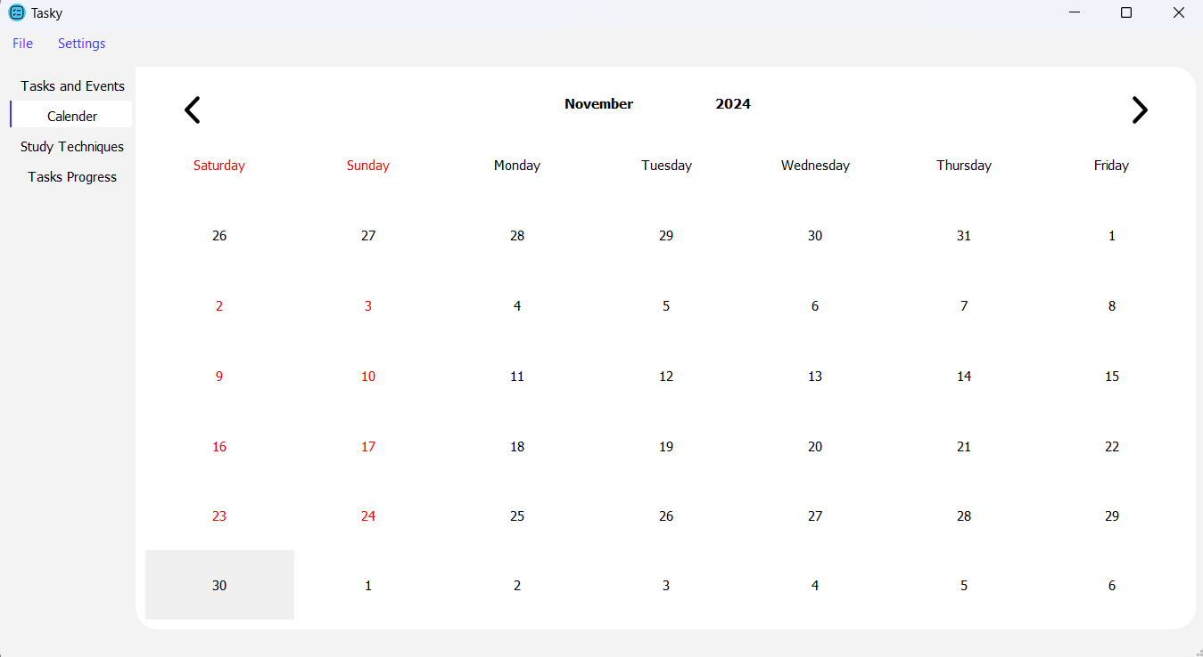
Tab Calender is a simple calender that will show the day of Due Date of a task or event, each with a different color. When clicking a day it will show a tooltip with the information of the task/event

Slide 7
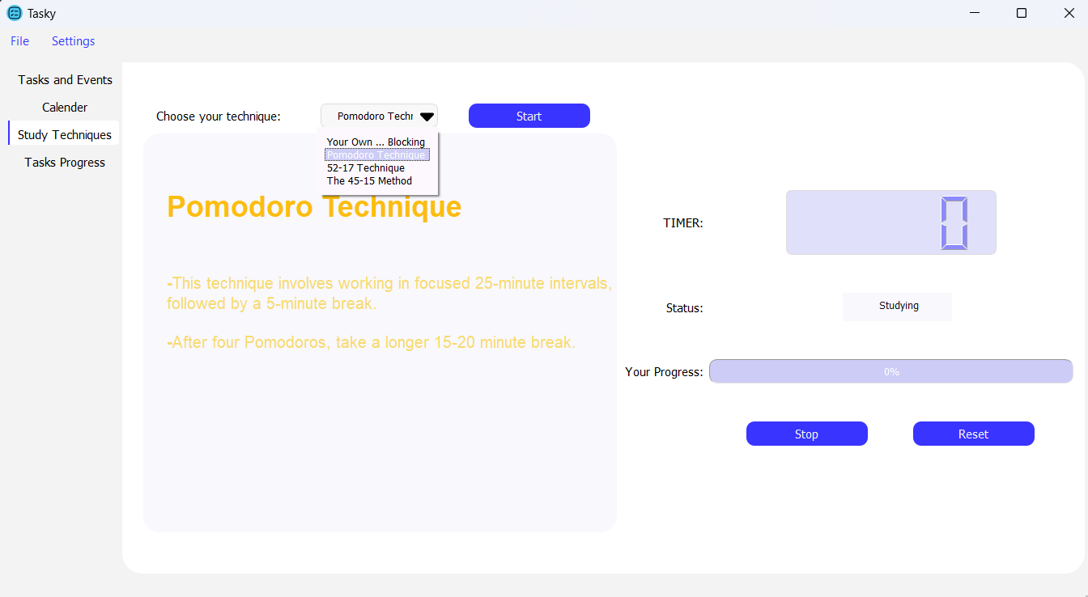
Tab Study Techniques is a tab to help focus on studying or any form of focus requiring work. It’s as follow: -When clicking Start, it’ll start a timer for you to study. -When the time ends it’s time to take a break so it’ll switch to a different timer. And so on. There are different study techniques, each with different study and break time. You can even set your own.

Slide 8
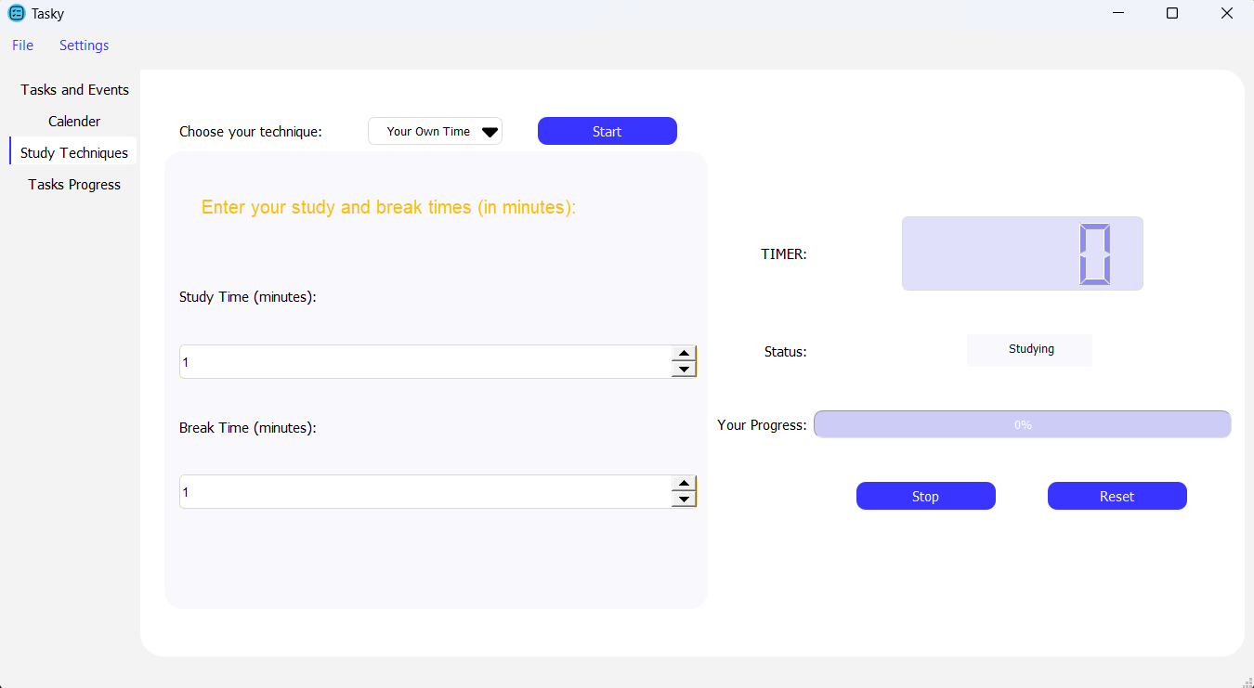

Slide 9
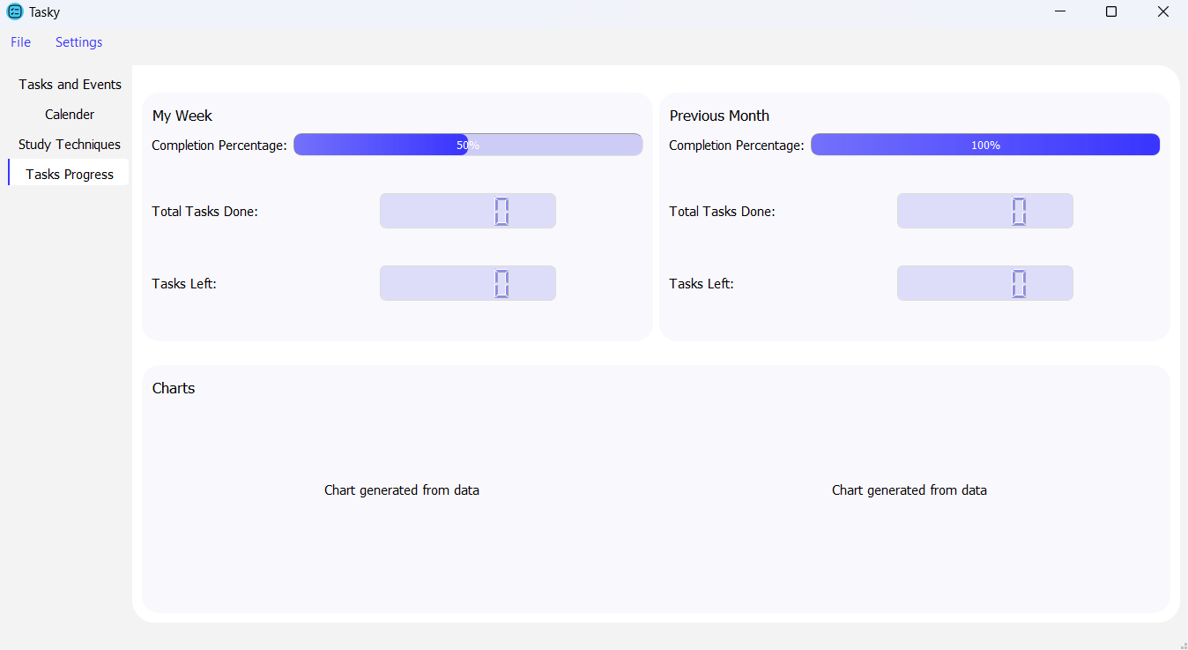
Last Tab Tasks Progress, self explanatory. Charts are yet to be decided upon.

Slide 10
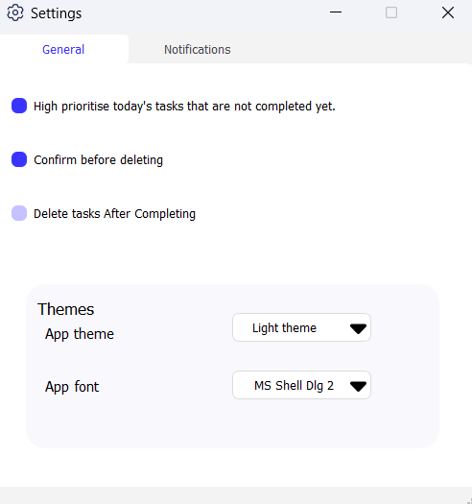
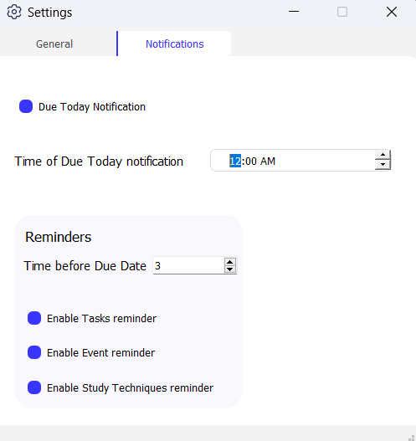
The Settings Window: General: Most are self explanatory. App theme makes you change between Light and Dark modes, App font lets you change the font of the app. Notifications: Are explained in the bubbles.
Set a time for a notification on the task’s due day.
Set a reminder to remind you before a task’s due date (in hours)
Enable/Disable the above reminder
Enable/Disable the above reminder
Reminds you if the app is minimized and timer is up.

Slide 11
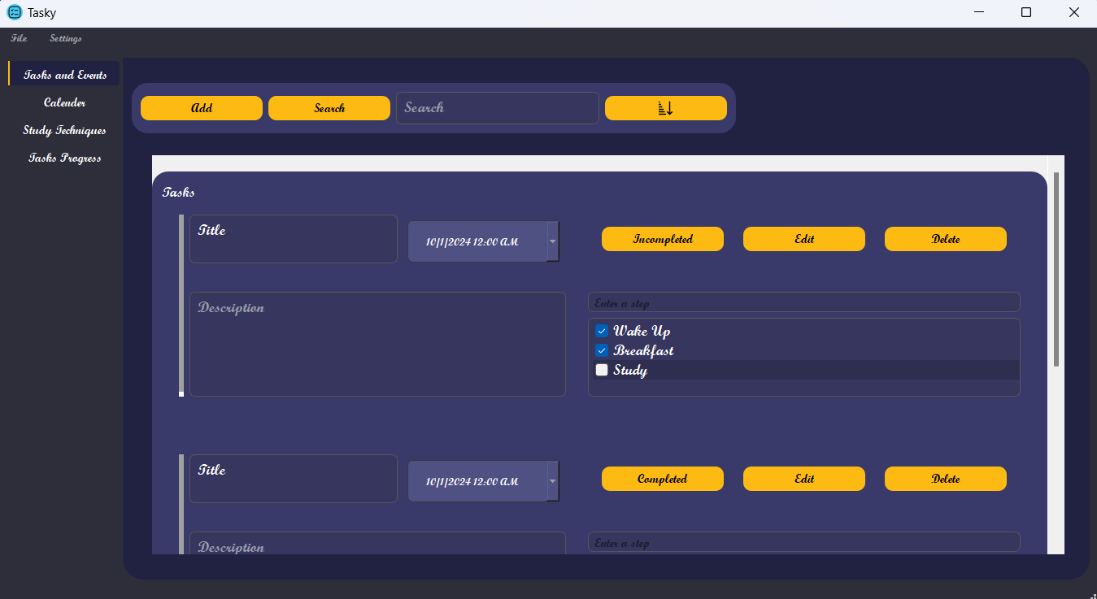

Slide 12
External links to code:
Currently our Github repo is private until we finish, so I’m providing a mediafire link of the code.
Link: https://www.mediafire.com/file/c46wm8rf26spbp1/Task_Management_App.zip/file
Steps to run app:
1- Install the following python library by running the following line in a terminal:
pip install pyqt5
2- Run the app by running the file “main.py” using a python interpreter.

